Slide 1
Introduction to Databases

Slide 2
About These Slides

Slide 3
About These Slides
Two slides per “slide”
Title Slide (for when I’m talking)
Details slide (for later)
Nobody likes it when you can read the slide just as well as the speaker can
I like slides that are useful

Slide 4
What is a Database?

Slide 5
“
A database is an organized collection of data. The data is typically organized to model relevant aspects of reality, in a way that supports processes requiring this information.
”
Source: Wikipedia
(Emphasis Mine)

Slide 6
Types of Database

Slide 7
SQL

Slide 8
SQL (Relational)
Highly Structured Data
Using Tables, Columns and Rows
One or more relationships exist between datas
Constraints
Primary Keys (a unique row identifier)
Unique Keys (one or more columns that must have unique values, either individually, or as a group)
Foreign Keys (a column value that must be derived from a column value in another table)
Indexes
A lookup for one, or multiple columns aggregate data

Slide 9
NoSQL

Slide 10
NoSQL (Document/Key-Value/Graph)
Sometimes called “Not Only SQL” because some NoSQL DBs have a SQL-like query language
Not always non-relational
Always unstructured
Intended to provide higher scalability and higher availability
Looser consistency models

Slide 11
Non-Relational

Slide 12
NoSQL (Document/Key-Value/Graph)
NoSQL is non-relational
Document Stores
Centers around the concept of a document, and it’s related meta-data
Collections of documents
Hierarchies of documents
Examples: Couchbase Server, CouchDB, MongoDB, Amazon SimpleDB, Oracle NoSQL DB
Key-Value Stores
Data stored and accessible directly by a unique key
Examples: Memcache, MongoDB, Couchbase Server, Cassandra, Riak, Amazon DynamoDB, Redis, Oracle NoSQL DB

Slide 13
Relational

Slide 14
NoSQL (Document/Key-Value/Graph)
NoSQL is relational (say what?!)
Graph Databases
All data is related to N other data
Relationships are in the data, not indexes
Examples: Neo4J, OQGraph for MySQL
Example Implementation: Facebook’s Graph API

Slide 15
A Note about MySQL

Slide 16
A Note on MySQL
MySQL supports multiple drivers (called engines) for it’s tables.
These engine provide different features.
The two most common are InnoDB (default since MySQL 5.5) and MyISAM (previously the default).
InnoDB has far more features, and is recommended for almost all situations
We will assume InnoDB for all MySQL examples

Slide 17
Relational Concepts

Slide 18
Relational Concepts
Schema
Tables
Indexes
Relationships
Stored Procedures
Triggers

Slide 19
Data Types

Slide 20
Name | What
int | exact whole numbers
decimal | exact decimal numbers (fixed length)
text | text
blob | binary data
NULL | Null values
Notes:
- Make sure to explain NULL fully

Slide 21
Create a Users Table

Slide 22
Users Table
Unique Identifier
Username
Password
Email Address
Name or First Name/Last Name
Column Names
Column Types
Consider:

Slide 23
User Table
User
id | int
username | text
password | text
email | text
first_name | text
last_name | text

Slide 24
Exercise 1: Create a User Table

Slide 25
User Table
CREATE TABLE
User
id | int
username | text
password | text
email | text
first_name | text
last_name | text
(
,
,
,
,
,
);

Slide 26
Users Table (Schema)
CREATE TABLE user (
id INT,
username TEXT,
password TEXT,
email TEXT,
first_name TEXT,
last_name TEXT
);

Slide 27
SQL

Slide 28
SQL: Four Main Queries
INSERT — Create Data
UPDATE — Update Existing Data
SELECT — Fetch Data
DELETE — Delete Data

Slide 29
CRUD

Slide 30
CRUD
C | reate | INSERT
R | etrieve | SELECT
U | pdate | UPDATE
D | elete | DELETE

Slide 31
Conditions

Slide 32
Conditions
Used with:
SELECT
UDPATE
DELETE
JOINs
Preceded by the WHERE, ON, USING, or HAVING keyword

Slide 33
Operators
Operator
= | Equality
<>, != | Inequality
< | Less Than
<= | Less Than or Equal To
> | Greater Than
>= | Greater Than or Equal To
IS NULL | NULL Equality
IS NOT NULL | NULL Inequality
AND | Boolean AND
OR | Boolean OR
BETWEEN | Range Equality

Slide 34
INSERT

Slide 35
INSERT
INSERT INTO table name (
list,
of,
columns
) VALUES (
"list",
"of",
"values"
);

Slide 36
Exercise 2: Insert a User

Slide 37
INSERT
INSERT INTO users (
id,
username,
password,
email,
first_name,
last_name
) VALUES (
1,
"dshafik",
"$2y$10$Ol/KS4/Bhs5ENUh7OpIDL.Gs1SIWDG.rPaBkPAjjQ2UTITI60YDmG",
"davey@engineyard.com",
"Davey",
"Shafik"
);

Slide 38
UPDATE

Slide 39
UPDATE
UPDATE
table name
SET
column = "some",
name = "value"
WHERE
some condition;

Slide 40
WARNING:
Don’t forget your conditions!
Otherwise you update every row in the table!

Slide 41
Exercise 3: Update a User

Slide 42
UPDATE
UPDATE
users
SET
username = "davey",
email = "davey@engineyard.com"
WHERE
id = 1;

Slide 43
SELECT

Slide 44
SELECT
SELECT
list,
of,
columns
FROM
table
WHERE
column = "some"
AND name = "value"
OR other_column = "other value"
ORDER BY some ASC, columns DESC
LIMIT start, offset;

Slide 45
Exercise 4: Select one User with a given username and password

Slide 46
SELECT
SELECT
*
FROM
users
WHERE
username = "davey"
AND password = "$2y$10$Ol..."
LIMIT 1;

Slide 47
Exercise 5: Select the First 10 Users

Slide 48
SELECT
SELECT
first_name, last_name, email
FROM
users
ORDER BY first_name, last_name
LIMIT 0, 10;

Slide 49
Exercise 6: Select the Next 10 Users

Slide 50
SELECT
SELECT
first_name, last_name, email
FROM
users
ORDER BY first_name, last_name
LIMIT 10, 10;

Slide 51
DELETE

Slide 52
DELETE
DELETE
FROM
table
WHERE
column = "some"
AND name = "value"
OR other_column = "other value"
ORDER BY some ASC, columns DESC
LIMIT number;

Slide 53
DELETE
DELETE FROM users;

Slide 54


Slide 55
Exercise 7: Delete a User

Slide 56
DELETE
DELETE FROM
users
WHERE
id = 1;

Slide 57
Constraints

Slide 58
Constraints: Users Table
IDs should be unique
Usernames should be unique
Passwords should not be unique
Email Address should be unique
First Name should not be unique
Last Name should not be unique
All column should not be NULL

Slide 59
Constraints: Users Table
Users |  | Constraints
id | int | not null, unique
username | text | not null, unique
password | text | not null
email | text | not null, unique
first_name | text | not null
last_name | text | not null

Slide 60
Constraints: Users Table Schema
DROP TABLE user;
CREATE TABLE user (
id INT NOT NULL UNIQUE,
username TEXT NOT NULL UNIQUE,
password TEXT NOT NULL,
email TEXT NOT NULL UNIQUE,
first_name TEXT NOT NULL,
last_name TEXT NOT NULL
);
Notes:
- NOT NULL option
- Have to use UNIQUE INDEX to get a UNIQUE constraint

Slide 61
Auto Increment

Slide 62
Users Table: Auto Increment
ID should be auto increment
ID should be the Primary Key

Slide 63
Features: Users Table Schema
CREATE TABLE users (
id INTEGER PRIMARY KEY AUTOINCREMENT NOT NULL,
username TEXT NOT NULL UNIQUE,
password TEXT NOT NULL,
email TEXT NOT NULL UNIQUE,
first_name TEXT NOT NULL,
last_name TEXT NOT NULL
);

Slide 64
Entries

Slide 65
Entry Table
Unique Identifier
Title
Article
Must link to the Users table
Consider:

Slide 66
Entry Table
Entry
id | int PRIMARY KEY AUTOINCREMENT
users_id | int
title | TEXT
article | TEXT

Slide 67
Entry Table Schema
CREATE TABLE entry (
id INT NOT NULL PRIMARY KEY AUTO_INCREMENT,
users_id INT NOT NULL,
title TEXT NOT NULL,
article TEXT NULL,
);

Slide 68
INSERT
INSERT INTO entry (
users_id,
title,
entry
) VALUES (
1,
"How to Write SQL",
"Writing SQL in PHP is fun and easy!"
);

Slide 69
JOINs

Slide 70
JOINs
Used to JOIN multiple tables
INNER JOIN
LEFT or RIGHT OUTER JOIN

Slide 71

INNER JOIN
Users
Entries
Users with Entries

Slide 72
OUTER JOIN

Slide 73

LEFT OUTER JOIN
Users
Entries
Users with Entries

Slide 74
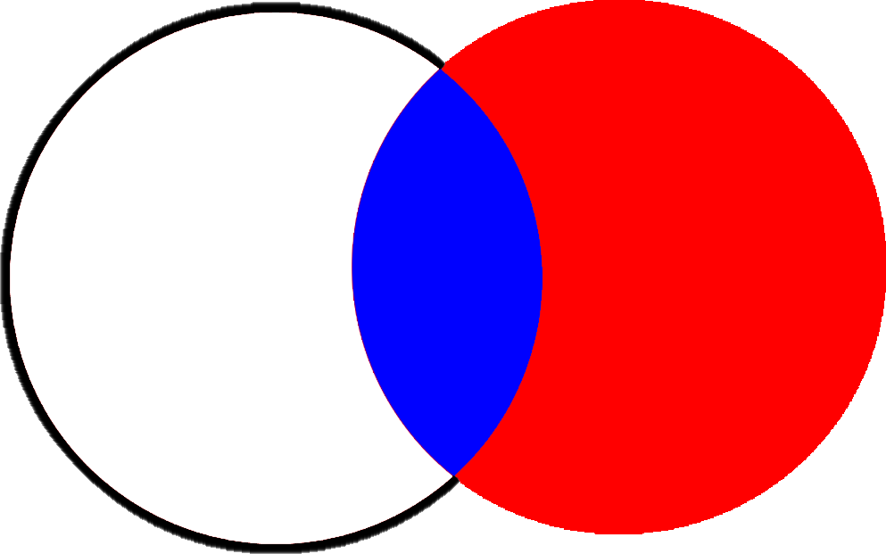
RIGHT OUTER JOIN
Users
Entries
Entries by Deleted Users
Entries with Users (Authors)

Slide 75
Exercise 8: Get a User and all their Entries

Slide 76
SELECT... INNER JOIN
SELECT * FROM
users
INNER JOIN entry
ON (
entry.user_id = users.id
)
WHERE entry.title LIKE '%PHPEmbark%'
ORDER BY entry.title ASC;

Slide 77
Exercise9: Get Users who may or may not have Entries

Slide 78
SELECT... LEFT OUTER JOIN
SELECT * FROM
users
LEFT OUTER JOIN entry
ON (
entry.user_id = users.id
)
WHERE
users.id = 1;

Slide 79
Exercise 10: Get a User, who might have posts, or have stuff tagged with ‘PHP’

Slide 80
SELECT... RIGHT OUTER JOIN
SELECT * FROM
user
LEFT OUTER JOIN entry
ON (
entry.user_id = users.id
) RIGHT OUTER JOIN tag
ON (
entry.tag_id = tag.id
)
WHERE
tag.name = 'PHP';

Slide 81
Databases and PHP

Slide 82
Connecting to Databases

Slide 83
Connecting to Databases
PDO
MySQL
PostgreSQL
MSSQL
Oracle
SQLite
ODBC and DB2
Firebird
DSN — Data Source Name
Driver Name
Hostname & Port
or
Unix Socket
Username
Password
Database Name
Charset
Connecting
new PDO()
Disconnecting
PDO::__destruct()

Slide 84
Connecting to SQLite
<?php
try {
$pdo = new \PDO("sqlite:/path/to/db.sqlite");
} catch (\PDOException $ex) {
error_log($ex->getMessage());
}
?>

Slide 85
Querying Data

Slide 86
Executing Queries
try {
$pdo = new \PDO(…);
$query = $pdo -> prepare(
"SELECT * FROM user WHERE id = :id"
);
$conditions = array(
':id' => 1
);
$result = $query->execute($conditions);
} catch (\PDOException $ex) {
error_log($ex->getMessage());
}

Slide 87
Handling Results

Slide 88
Handling Results
<?php
$result = $query->execute($conditions);
if ($result) { echo "Results Found: " .$query->rowCount();
while ($row = $query->fetch()) {
echo "<a href='/edit/" .$row['id']. "'>"
.$row['first_name']. ' '
. $row['last_name'] .'</a>';
}
}
?>

Slide 89
Handling Results as Objects
<?php
$result = $query->execute($conditions);
if ($result) {
echo "Results Found: " .$query->rowCount();
while ($row = $query->fetchObject()) {
echo "<a href='/edit/" .$row->id. "'>"
.$row->first_name. ' '
. $row->last_name .'</a>';
}
}
?>

Slide 90
Handling Results as Custom Objects
class User {
function getName() {
return $this->first_name
. ' ' . $this->last_name;
}
}
if ($result) {
echo "Results Found: " .$query->rowCount();
while ($row = $query->fetchObject("User")) {
echo "<a href='/edit/" .$row->id. "'>"
.$row->getName().
'</a>';
}
}

